Slide 1
Data Refresh in Power BI
When your datasets are published to your organization's workspace in Microsoft Power BI service, everyone who needs access to those datasets can find them in a central location, which provides opportunities for collaboration between teams.
It also reduces the duplication of effort because one dataset can be used by multiple users for different business reasons. For instance, one dataset can be used to create multiple Power BI reports. Because preparing and cleaning data can be time-consuming, sharing datasets can be a productivity boost for report authors.
Power BI enables you to go from data to insight to action quickly, yet you must make sure the data in your Power BI reports and dashboards is recent.
Knowing how to refresh the data is often critical in delivering accurate results.

Slide 2
Data Refresh in Power BI
For Power BI users, refreshing data typically means importing data from the original data sources into a dataset, either based on a refresh schedule or on-demand.
You can perform multiple dataset refreshes daily, which might be necessary if the underlying source data changes frequently. Power BI limits datasets on shared capacity to eight scheduled daily dataset refreshes

Slide 3
Data Refresh in Power BI
Use a Power BI gateway to connect to on-premises data sources
Gateway software acts like a bridge; it allows organizations to retain databases and other data sources on their on-premises networks and access that on-premises data in cloud services, such as Power BI and Microsoft Azure Analysis Services.
A gateway facilitates quick, behind-the-scenes communication that flows from a user in the cloud to your on-premises data source and then back again to the cloud

Slide 4
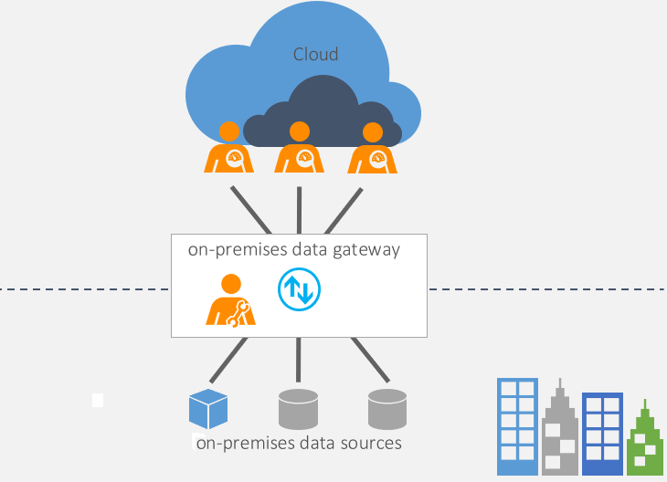
Data Refresh in Power BI

Slide 5
Data Refresh in Power BI
Two types of on-premises gateways are:
Organization mode - Allows multiple users to connect to multiple on-premises data sources and is suitable for complex scenarios.
Personal mode - Allows one user to connect to data sources. This type of gateway can be used only with Power BI and it can't be shared with other users, so it is suitable in situations where you're the only one in your organization who creates reports. You will install the gateway on your local computer, which needs to stay online for the gateway to work.
https://learn.microsoft.com/en-us/training/modules/manage-datasets-power-bi/5-dataset-refresh

